Slide 1
Final Project
Sean Dulce
Bus 3252.01

Slide 2
Income level and average tax rate
This project will study the correlations and statistics of the different income level residents in the U.S. I will be using a data set from data.gov called "High Income Resident Tax Returns by Income level and Average Tax Rate" to study this subject.
The choice for this topic is because I believe it is interesting to study the relationships between the different income levels and how they differ when it comes to taxes and other correlations this study may bring.
This results of this study may benefit various groups of people like teachers in finance and economics, financial advisors, tax professionals, government officials concerning tax laws, and even other students in finance or economics that may be interested in this topic.

Slide 3
Data overview
The dataset "High Income Returns by Income Level and Average Tax Rate" columns consist of the following:
Taxable Year(Nominal): The year in which the tax data was reported.
Category(Nominal): Tax category type.
AGIC(Ordinal): Adjusted Gross Income bracket.
Total Returns(Ratio): Total number of tax returns filed for a given AGI bracket.
Non-Taxable Returns(Ratio): Number of returns where no taxes were owed.
Taxable Returns(Ratio): Number of returns where taxes were owed.
Total Tax Liability(Ratio): Total dollar amount of taxes owed in that income bracket.
Average Tax Rate Less Than 1%(Ratio): Number of filers in that AGI bracket with less than 1% average tax rate.
Average Tax Rate 1% to 9%(Ratio): Number of filers in with the tax rate of 1% to 9%.
Average Tax Rate 9% and Above(Ratio): Number of filers in with the tax rate of 9% and above.

Slide 4
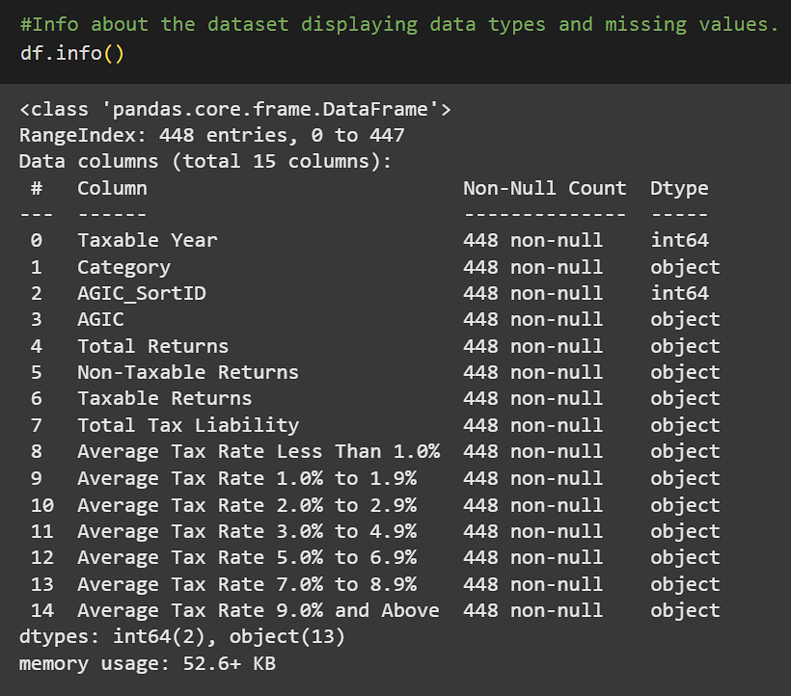
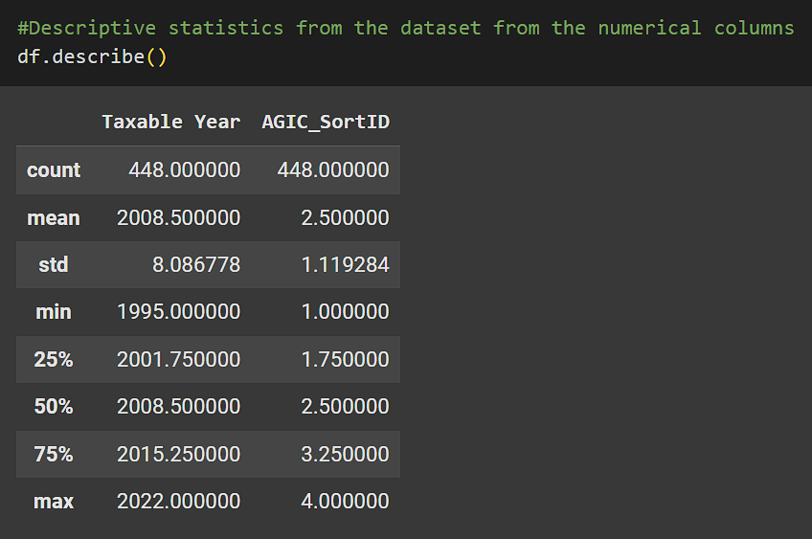
Data exploration
Initial exploration of the dataset by utilizing the info(), describe(), and value_counts() functions.

Slide 5
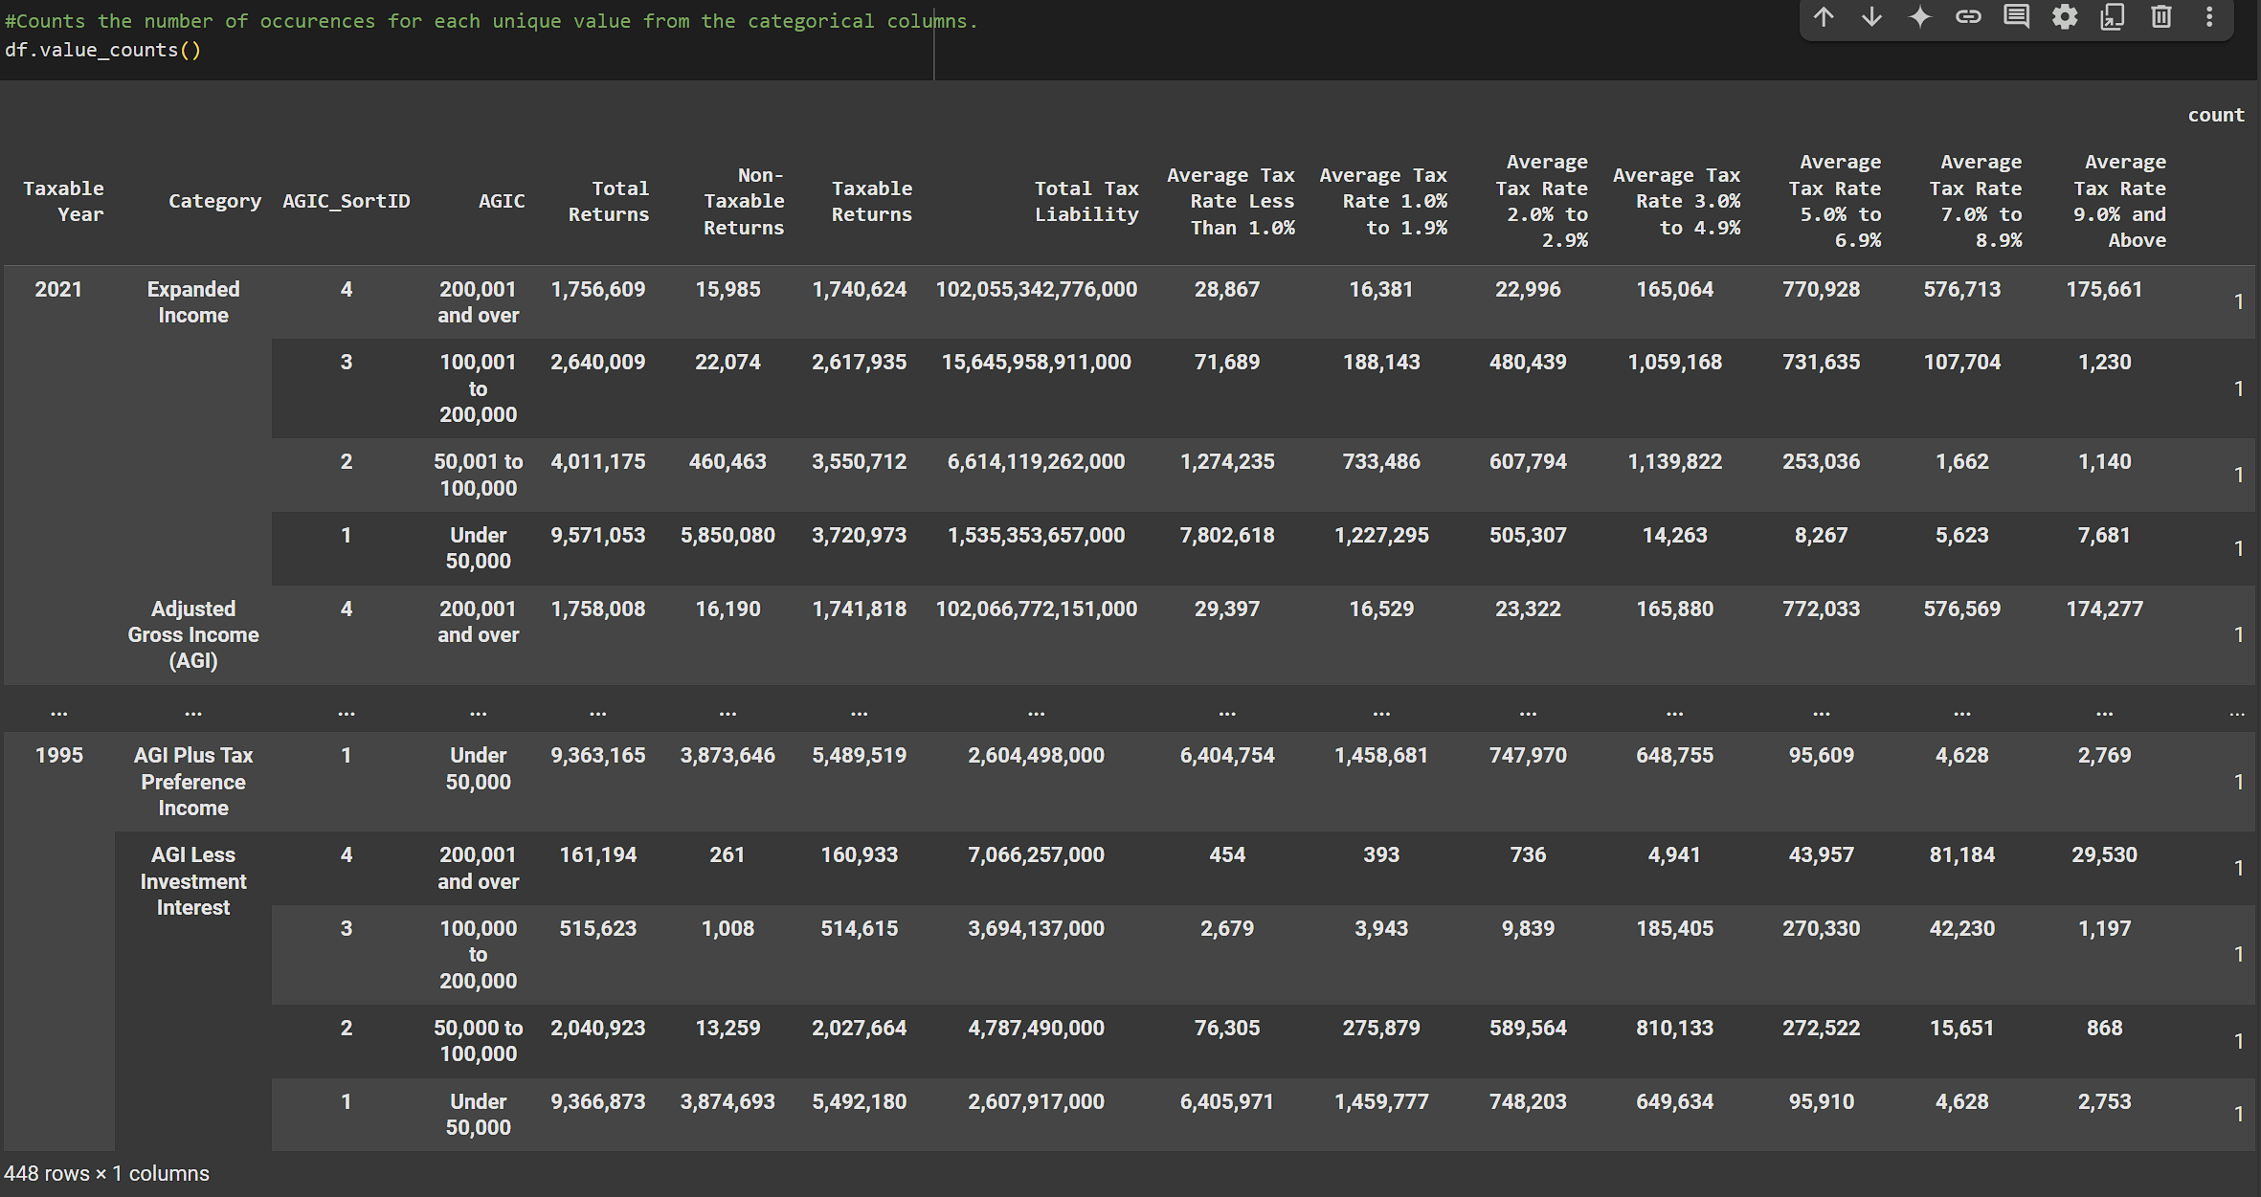
Data exploration
continued

Slide 6
Data exploration
Basic observations
All the columns in the dataset appear to have 0 missing values
Some inconsistencies were identified in the income bracket labels. Specifically, entries like '50,000 to 100,000' and '50,001 to 100,000', or '100,000 to 200,000' and '100,001 to 200,000’. This maybe intended to be separate categories but it can potentially lead to errors and misleading analysis later on the project.
Total Returns range from 161,263 to 10,580,982, with an average of about 3,738,478 returns per entry. The standard deviation is about 2.9 million, suggesting a wide spread amount of how many returns are filed across income levels and years.
Non-Taxable Returns range from 261 to 6,917,812, with an average of about 1,399,045. The low minimum and high maximum return amounts indicate that some income brackets have almost no non-taxable returns, while others have a majority.

Slide 7
Data exploration
Basic observations CONTINUED
Taxable Returns range from 160,694 to 5,661,725, with an average of about 2,339,433, showing variability, but more consistency than non-taxable returns.
Total Tax Liability ranges from 1,377,564,752 to 102,268,607,839,708, and the high maximum compared to the average 6.7 trillion reveals a very right-skewed distribution which means a few income brackets account for the majority of tax revenue.
Finally, the Total Tax Liability column contained extremely large values (in the trillions), which were likely recorded in cents. This will require scaling the values down to ensure accurate calculations and visualization of average tax amounts.

Slide 8
Data Preprocessing
This process helps prepare raw data from the dataset for our analysis. In order to start this process we must complete 2 methods of Data Preprocessing.
Cleaning Data and Data Aggregation are the best methods to use for this particular dataset.
Cleaning Data is needed in order to make sure the data has no missing values, or duplicates, in order to reduce the risk of errors when analyzing the data through visualization. It also ensures that the data is standardized and any white spaces are removed to further ensure aggregation and visualization will be completed accurately.
Data Aggregation will be used to group up multiple pieces of data and summarize them into more readable rows of data which can help with the answering any analytical questions and the visualizations.
(cleaning data and aggregation code and output can be found in the google collab)

Slide 9
Analytical questions
Question 1: What percentage of tax returns are taxable in each income bracket?
This question is valuable as it will reveal how many individuals per income group have taxable returns by percentage wise. We will also find out how big the percentage gap of taxable returns is between each income level.
Question 2: How does the average tax paid per taxable return vary across income levels?
This question is valuable as it will specifically reveal how much the average tax paid per return for each income levels. We will be able to see the exact dollar amount of the income disparity between levels based on how much each level owes on average.

Slide 10
Analytical questions
Question 3: Which income bracket contributes the most to total tax revenue and how does it compare to the total tax returns per income bracket?
This question will reveal which income group contributes most total tax revenue and compare it to the total tax returns per income group. This will show us the correlation between the two categories and show us where all the tax revenue comes from and how big that income group really is.
(Question answers will be paired with the visualization slides)

Slide 11
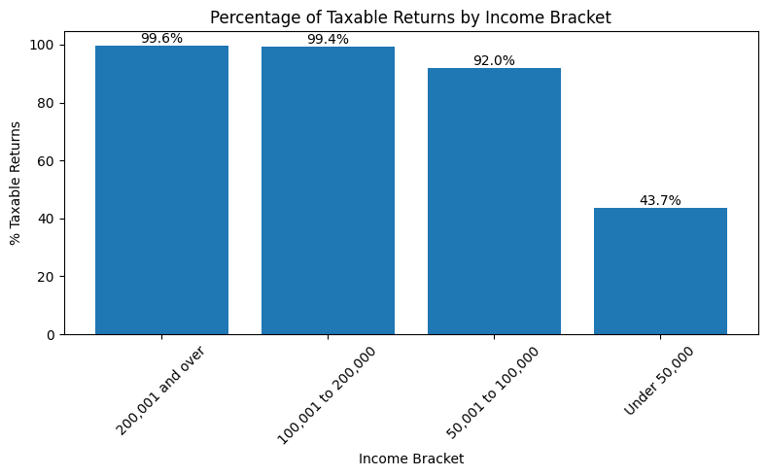
Data visualization
Insights: Based on our visualization, most taxable returns come from individuals that fall under any of the income brackets that are over 50,000. On the contrary, of all the individuals in the under 50,000 income bracket, only 43.7% of them have a taxable return.
Of the individuals in the 50,001 to 100,000 income bracket, 92% of them have taxable returns while individuals for both income brackets that are 100,000 and over are at 99% of taxable returns within the brackets.
This answers question 1.

Slide 12
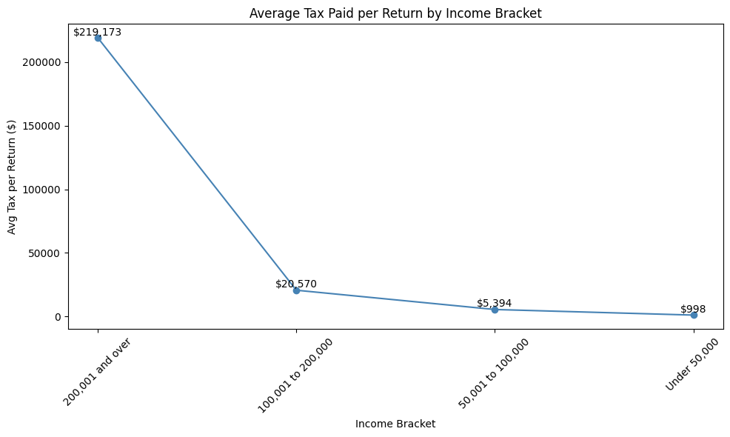
Data visualization part 2
Insights: Based on this visualization, it seems that the income bracket 200,000 and over has a huge disparity compared to the other income brackets with an average of $219,173 tax paid which is a whopping 90% higher average tax paid than the next income bracket of 100,000 to 200,000. At the opposite side of the spectrum, the income bracket of 50,000 and under sits at a $998 average tax paid.
Completing question 2, the 100,000 to 200,000 group pays an average $20,570 tax paid and the 50,000 to 100,000 group pays an average $5,394.

Slide 13
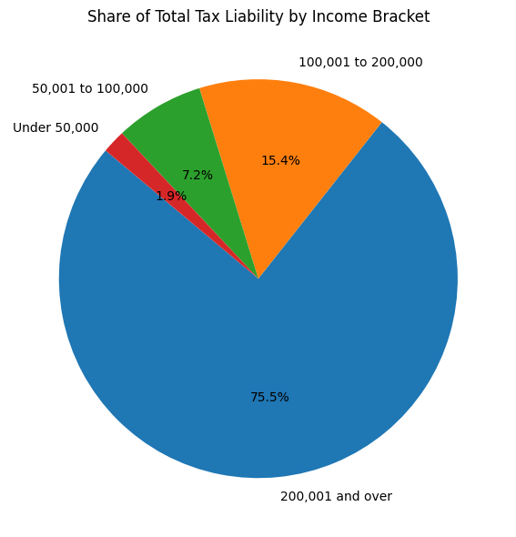
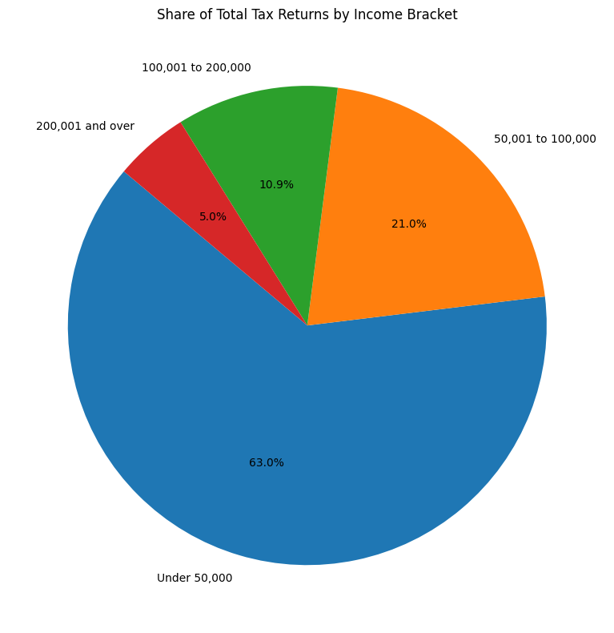
Data visualization part 3

Slide 14
Data visualization part 3
CONTINUED
Share of Total Tax Liability by Income Bracket Pie Chart
Insights: Based on this pie chart, it seems that the 200,000 and over income bracket contributes to the most total tax revenue at 75.5%. The next runner up being 100,000 to 200,000 at a low 15.4% and the next income levels combining for ~9% of the total tax liability.
Share of Total Tax Returns by Income Bracket Pie Chart
Insights: Based on this pie chart, 63% of total tax returns comes from the under 50,000 income bracket. The income bracket of 50,000 to 100,000 comes in at second with 21% of total tax returns and both income brackets of 100,000 and over combine for ~16% of total tax returns.
Answering question 3, even though the income bracket of 200,000 and over contributes the most tax revenue at 75.5%, they only make up 5% of total tax returns. On the other end, the bracket of 50,000 and under contribute 63% of total tax returns but only they have 1.9% tax liability.

Slide 15

Key takeaways
3 key takeaways:
The first takeaway that came from this analysis is that if your income level increases so will your taxable return increase, with the biggest jump starting at $200,000.
The second takeaway is that almost 100% of high income individuals have a taxable return, while most low income individuals have a non-taxable return.
The last takeaway is most tax filers come from the under 50,000 income bracket. So even though most of the tax liability comes from high income individuals, most individuals tax returns fall under the 50,000 and under income level.
Lessons learned:
Overall, this project was good practice for data analytics as I learned to find a dataset and process it into collab. From there the preprocessing was probably the most important part of the project as I learned anything from preprocessing the raw data will affect the visualization and end results depending on if the dataset is properly cleaned and scaled.

Slide 16
REferences
California Franchise Tax Board. (2024). B-9.1: High income returns by income level and average tax rate [Dataset]. Data.gov. https://catalog.data.gov/dataset/b-9-1-high-income-returns-by-income-level-and-average-tax-rate

